Slide 1

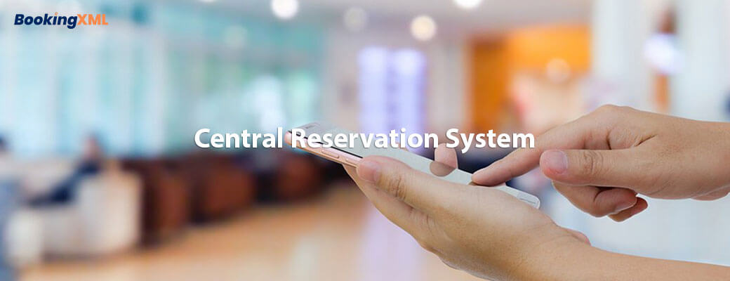
Central reservation system
https://www.bookingxml.com/central-reservation-system.php

Slide 2

Central reservation system and how it is beneficial for travel agent
A Central Reservation System (CRS) is web-based software that travel agencies and travel management companies use to retrieve and conduct transactions related to air travel, hotels, car rental, and other activities.
The primary goal of CRS System software was to create a one-stop service shop and eliminate physical and geographical barriers between mediators and consumers. These distribution systems, which have global coverage provide information to airlines, hotels, car rental companies, travel agencies, corporations, and others

Slide 3
What do you get with CRS integration?
The CRS central reservation system has evolved one of the most widely used tools in the tourism industry. It has transformed the whole industry.
The CRS software allows travel agents to promote sales and provide real-time detailed information on availability, price, reservation, and booking of products or services.
Through continuous innovation, Booking XML is shaping the future of travel technology by providing more choice and simplicity for travelers.
We are proud to be able to connect you to all of the major CRS systems.

Slide 4
Some of the basic functions of our central reservations system:
Booking and inventory management are enabled.
Display the products and services provided by various tourism providers.
Passengers or Guest name records.
User-friendly reservation system.
Customer data management.
Displays travel services with prices and images.
It is an easy-to-use system that facilitates email notification and payment gateway integration.

Slide 5
Some benefits of central reservation system:
High-speed information infrastructure network.
Fare quote, ticketing, and voucher generating process.
Appropriate for both B2B and B2C business models.
CRS are web-based application that save a significant amount of time on administration tasks
Offers custom reporting
Keeping track of customer service information such as PNRs.

Slide 6
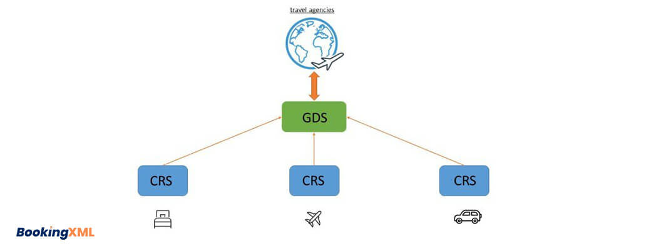
Major central reservation systems?
Airline Central Reservation Systems
Car Rental Central Reservation Systems
Hotel Central Reservation Systems

Slide 7
Airline central reservation system
Airline Central Reservation System is one of the most commonly used tools in travel and tourism.
The airline computer reservation system manages the booking system as well as flight details, inventories, and prices.
BookingXML Airlines CRS connects and enables you to sell your inventory through all B2B/B2C sales channels, including online travel agencies(OTAs).

Slide 8
Some features of the airline CRS system:
B2B – Travel Agents Reservation
B2C – End user Reservation
User friendly reservation system
Booking cancellation and refund management
GDS integration – amadeus, sabre, worldspan, galileo, abacus
Airline Mobile booking app(Android & iOS)

Slide 9
Car rental crs
Car CRS is one of the most versatile solutions for car hire companies need to provide the fastest and optimum service to their customers
BookingXML is a leading travel technology company that provides customized car CRS systems for global agents, drivers, car operators, car rentals agencies, and car rental operators.
It is complete online car rental reservation software that allows you to easily manage online car rental operations and generate reliable reports.

Slide 10
Key features of car crs system:
Customization
Reporting
Easy management of booking and quotation
Car control and security
Cost saving
Customer service

Slide 11
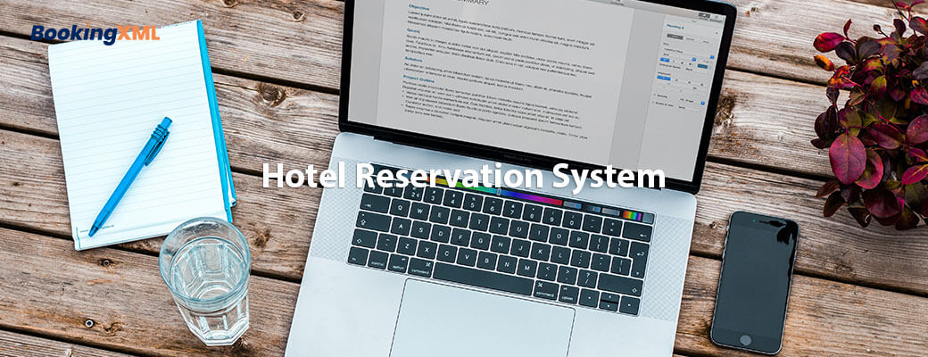
Hotel central reservation system
It is a computerized reservation system that helps hoteliers manage reservations and other processes by keeping hotel information and availability up to date.
Implementing a CRS can helps hotels remain updated with trends.
Hotel CRS is a hotel reservation system that manages hotel data, room inventory, rates, hotel availability, and reservations in real-time.

Slide 12
Hotel crs improve profitability and efficiency
Increase efficiency: A CRS enables hotels to distribute their rates and inventory, as well as receive a booking, through a single system- a hotel only needs to input rates and mange inventory through one backend rather than manually updating rates across multiple channels.
Grows distribution: A CRS reservation system connects hotels to a large network of travel distributors, allowing the hotel to reach out to various types of sellers in many different global markets.
Delivers insight: A CRS provides hotel revenue manager with a bird’s-eye view of their pricing and inventory allocations across all distribution channels, allowing them to quickly adapt to market changes as needed.

Slide 13
Features of hotel crs system:
Fast booking system
Fully customized system
Easy hotel search option
User-Friendly system
Mobile-friendly design
Multilanguage support
Quick customer support

Slide 14
Contact us
For more details, please visit our website : https://www.bookingxml.com/central-reservation-system.php

